Slide 1

NON FUNCTIONAL TESTING
Submitted to:Mrs.Raman bhinder
Submitted by:Yogesh Arora
REG_ID:- 428

Slide 2
CONTENT
SECURITY TESTING
AUTOMATION TESTING
PERFORMANCE TESTING
LOAD TESTING
STRESS TESTING
VOLUME TESTING
RECOVERY TESTING
API TESTING
PUZZLE 1
PUZZLE 2

Slide 3
NON FUNCTIONAL TESTING
Non-functional testing demonstrates HOW WELL the product behaves.
Non-Functional testing is a software testing technique that verifies the attributes of the system such as memory leaks, performance or robustness of the system. Non-Functional testing is performed at all test levels.

Slide 4

SECURITY TESTING
Security testing is basically to check that whether the application or the product is secured or not.
For eg: Can anyone came tomorrow and hack the system or login the application without any authorization. It is a process to determine that an information system protects data and maintains functionality as intended.

Slide 5
AUTOMATION TESTING
Automation testing is a technique uses an application to implement entire life cycle of the software in less time and provides efficiency and effectiveness to the testing software.
Automation testing is an Automatic technique where the tester writes scripts by own and uses suitable software to test the software. It is basically an automation process of a manual process. Like regression testing, Automation testing also used to test the application from load, performance and stress point of view.

Slide 6
WHY AUTOMATION TESTING?
Suppose any software has come up with new releases and bug fixes, then how will you ensure about that the new released software with bug fixes has not introduced any new bug in previous working functionality? So it’s better to test the software with old functionalities too.
It is difficult to test manually all functionalities of the software every time with the addition of some bug fixes or new functionalities. So, it is better to test software every time by Automation testing technique using Automation Tool efficiently and effectively. It is effective in terms of cost, resources, Time etc.

Slide 7
PERFORMANCE TESTING
Performance testing is testing that is performed, to determine how fast some aspect of a system performs under a particular workload. It can serve different purposes like.
It can demonstrate that the system meets performance criteria. It can compare two systems to find which performs better. Or it can measure what part of the system or workload causes the system to perform badly.

Slide 8
LOAD TESTING
A load test is usually conducted to understand the behavior of the application under a specific expected load. Load testing is performed to determine a system’s behavior under both normal and at peak conditions.
It helps to identify the maximum operating capacity of an application as well as any bottlenecks and determine which element is causing degradation
E.g. If the number of users are in creased then how much CPU, memory will be consumed, what is the network and bandwidth response time.

Slide 9
STRESS TESTING
It involves testing beyond normal operational capacity, often to a breaking point, in order to observe the results. It is a form of testing that is used to determine the stability of a given system.
It put greater emphasis on robustness, availability, and error handling under a heavy load, rather than on what would be considered correct behavior under normal circumstances. The goals of such tests may be to ensure the software does not crash in conditions of insufficient computational resources (such as memory or disk space).

Slide 10
VOLUME TESTING
Volume testing refers to testing a software application or the product with a certain amount of data.
E.g., if we want to volume test our application with a specific database size, we need to expand our database to that size and then test the application’s performance on it.

Slide 11
RECOVERY TESTING
Recovery testing is done in order to check how fast and better the application can recover after it has gone through any type of crash or hardware failure etc.
For example, when an application is receiving data from a network, unplug the connecting cable. After some time, plug the cable back in and analyze the application’s ability to continue receiving data from the point at which the network connection got disappeared. Restart the system while a browser has a definite number of sessions and check whether the browser is able to recover all of them or not.

Slide 12
API TESTING
API stands for application programming interface, which specifies how one component should interact with the other. It consists of a set of routines, protocols and tools for building the software applications.
In order to discuss API and Web services testing, we need to first identify what is an API and how it works.
It is to connect an application to the web and to other APIs.
An application is made of three essential parts that ideally should be able to work and communicate in a segmented way, so one could be swapped out for another.

Slide 13
1. DATA TIER:-Where data is retrieved from the database and file system and then stored.
2.LOGIC TIER:-The brain of the application, this processes the data between the layers, coordinating the application, processing commands, and making logical decisions. This layer is made of the API.
3.PRESENTATION TIER:-This top layer of the app is the user interface, which translates tasks into something the user understands.
API is the brain of our connected world, APIs allow for companies to become more agile, for things to go mobile, and everything to work together in a streamlined, integrated way

Slide 14
Most importantly, this tests that the API returns a correct response or output under varying conditions. This output is typically one of these three:
A Pass or Fail status
Data or information
A call to another API
. This involves configuring the database and server for the application’s requirements. Once you’ve set up your API testing environment, make an API call right away to make sure nothing is broken before you go forward to start your more thorough testing.

Slide 15
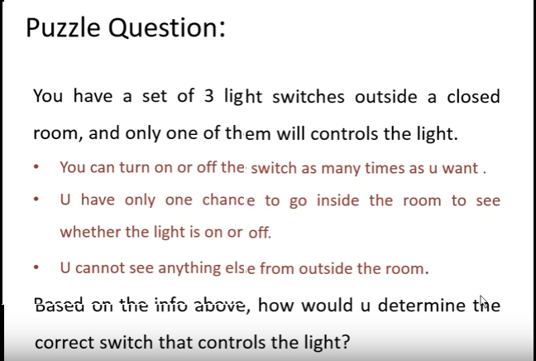
PUZZLE 1

Slide 16
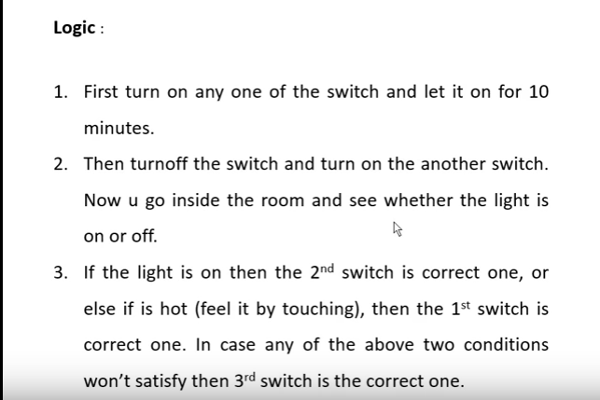
ANSWER

Slide 17

PUZZLE 2

Slide 18
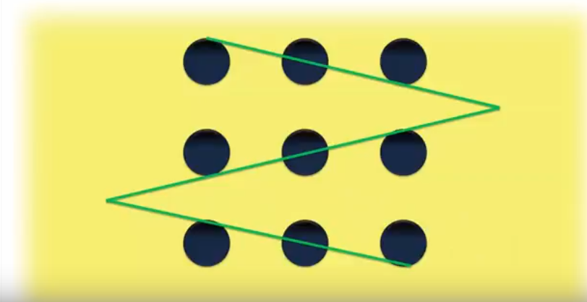
ANSWER

Slide 19


